Slide 1
Lecture 11 – Introduction to Reinforcement learning

Slide 2
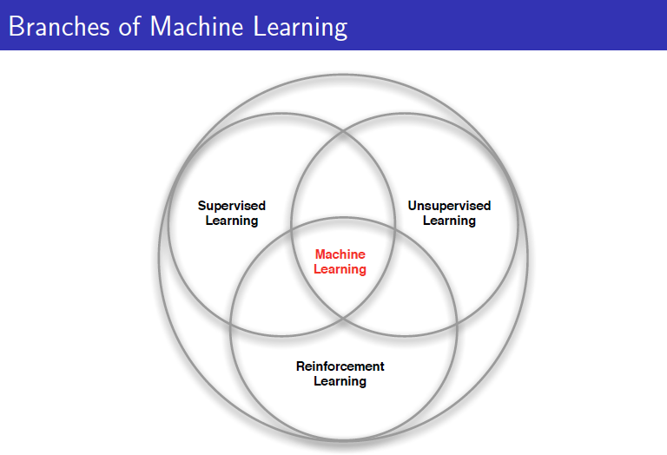

Slide 3
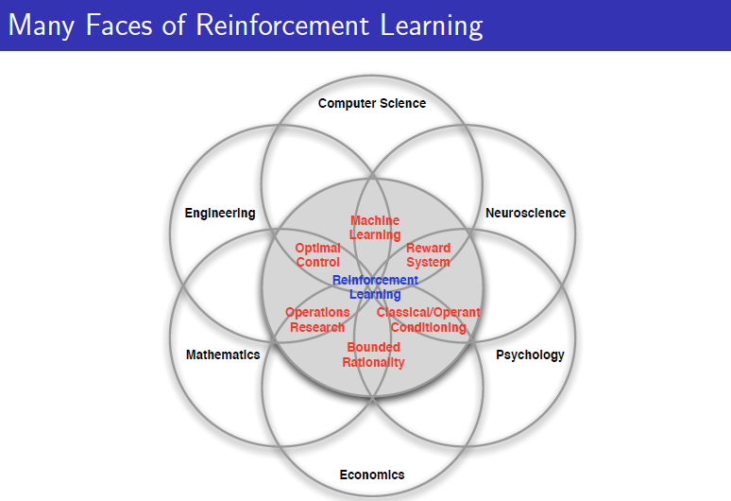

Slide 4
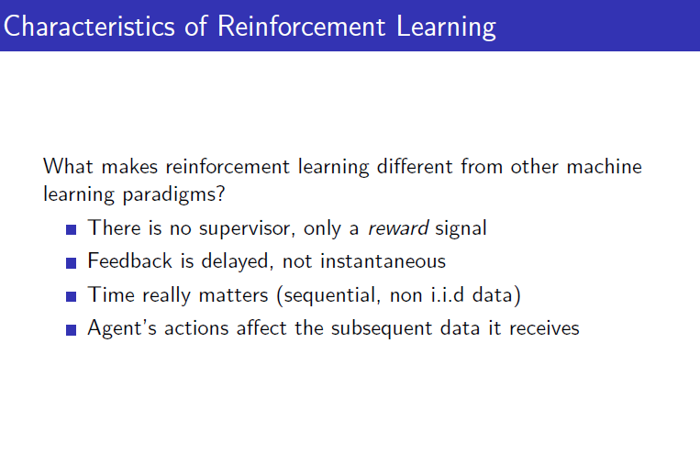

Slide 5
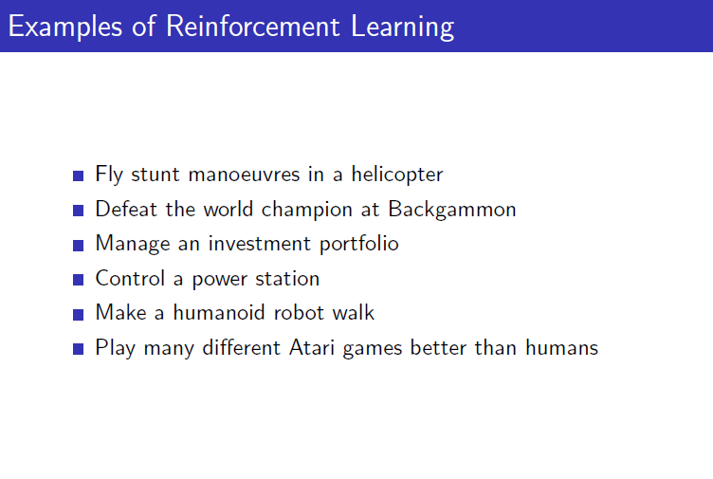

Slide 6
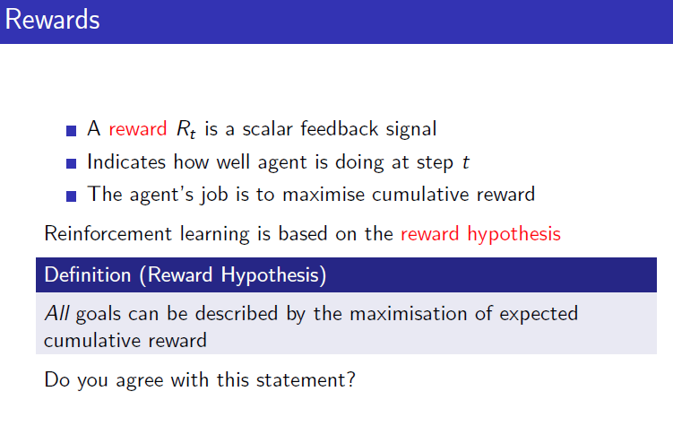

Slide 7
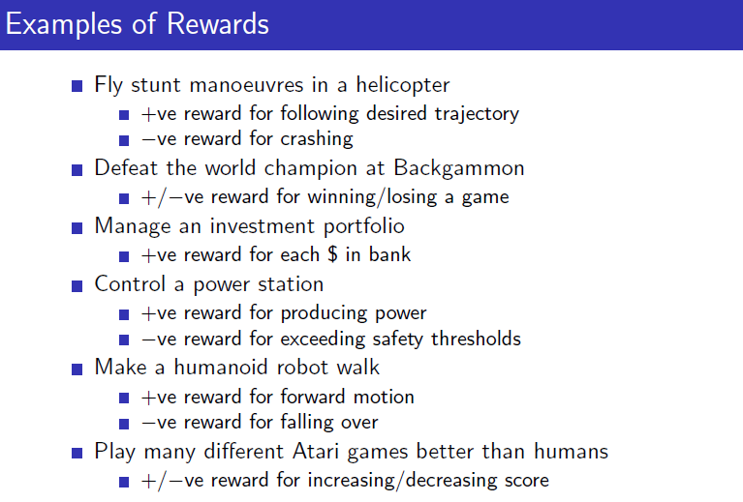

Slide 8
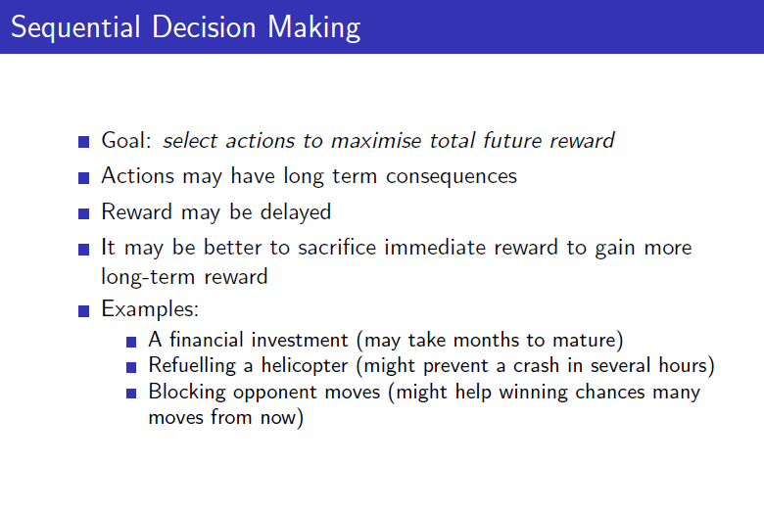

Slide 9
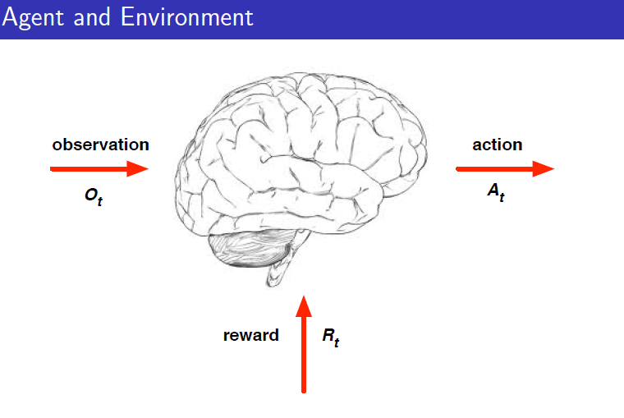

Slide 10
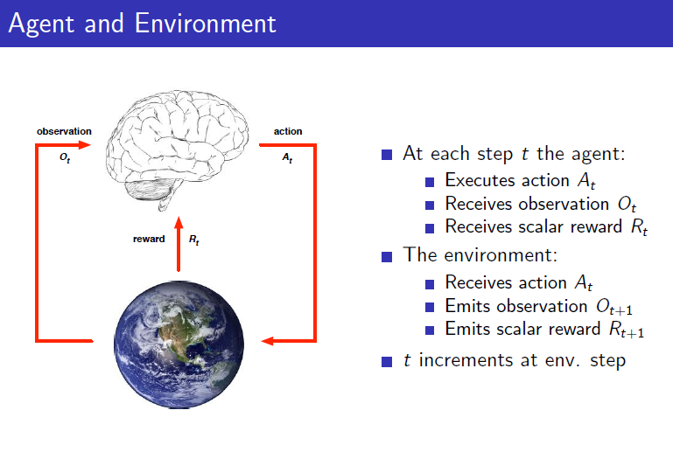

Slide 11
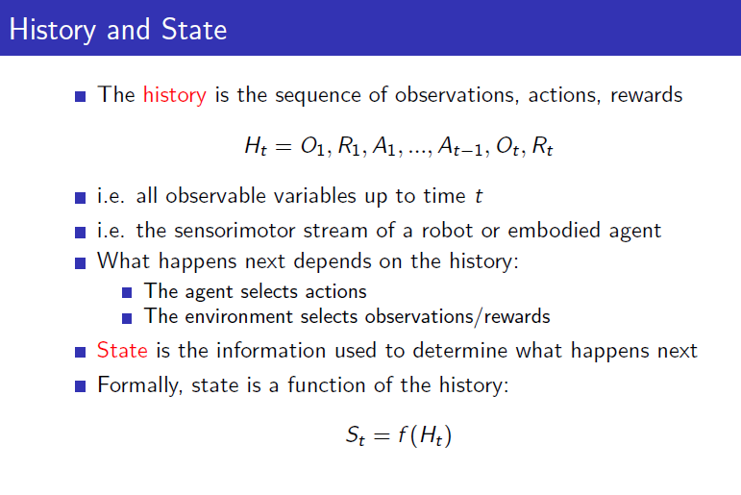

Slide 12
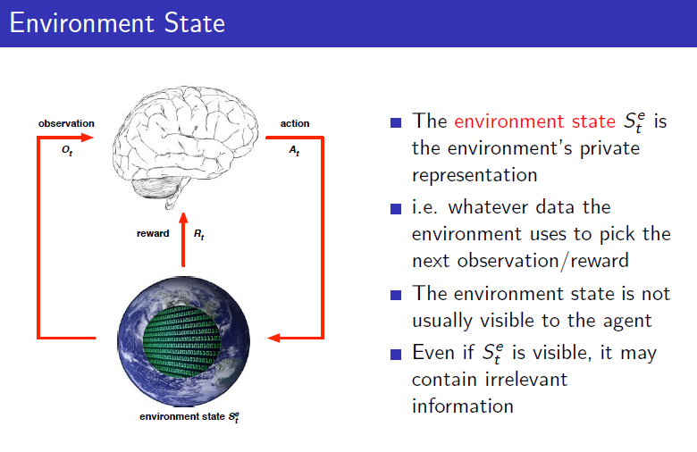

Slide 13
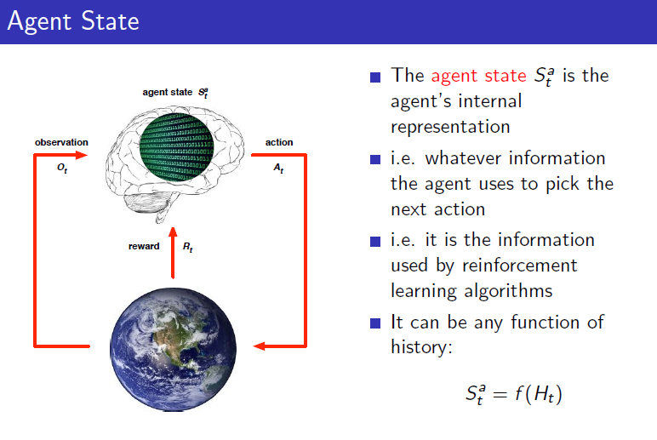

Slide 14
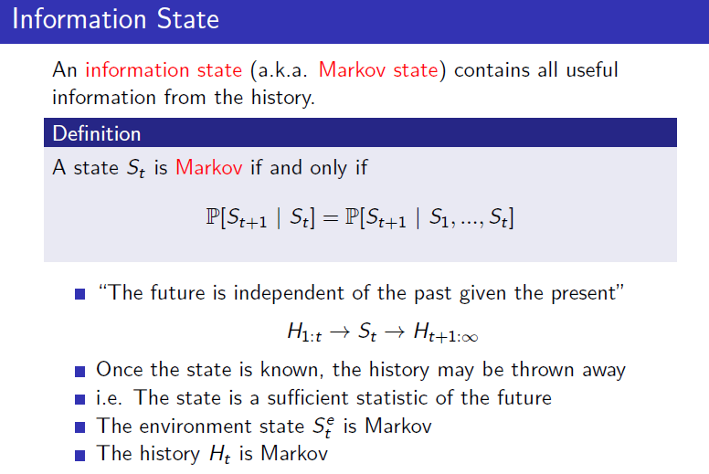

Slide 15
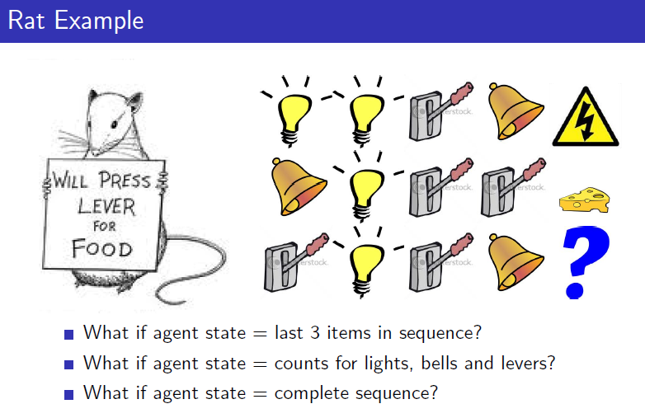

Slide 16
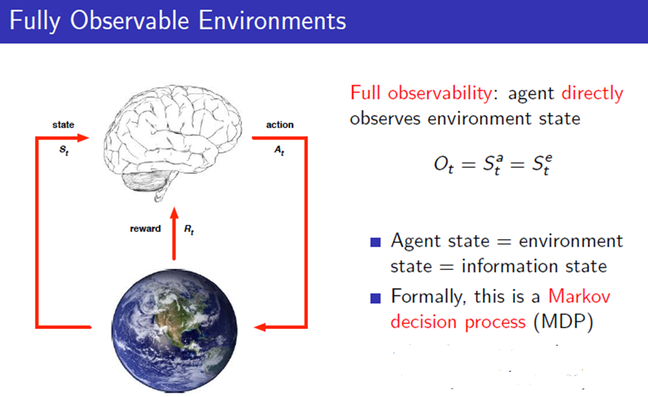

Slide 17
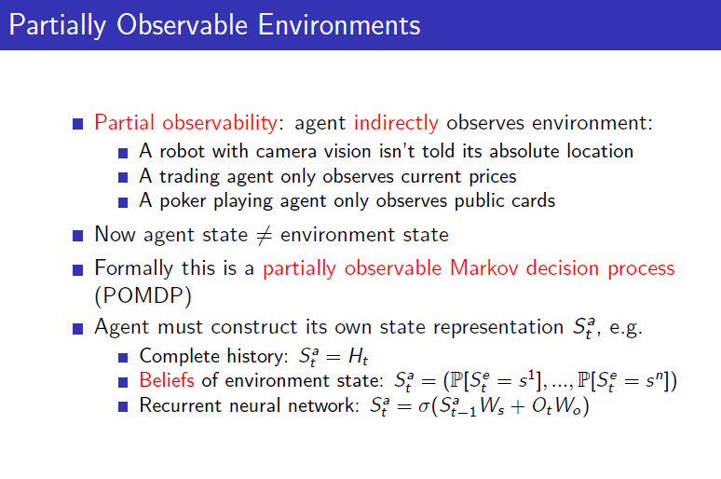

Slide 18
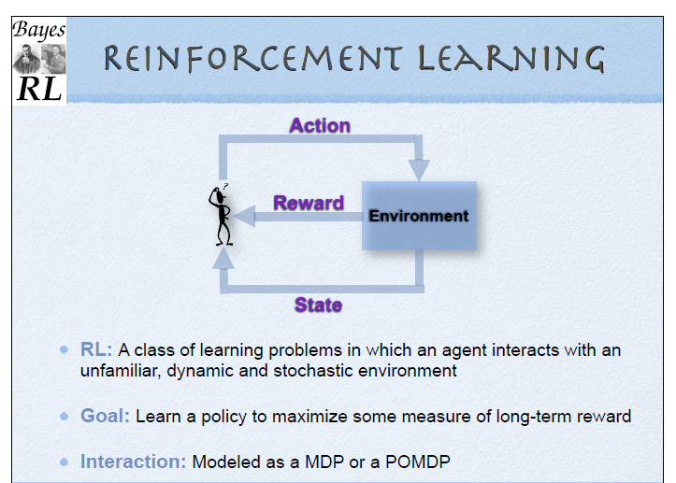

Slide 19
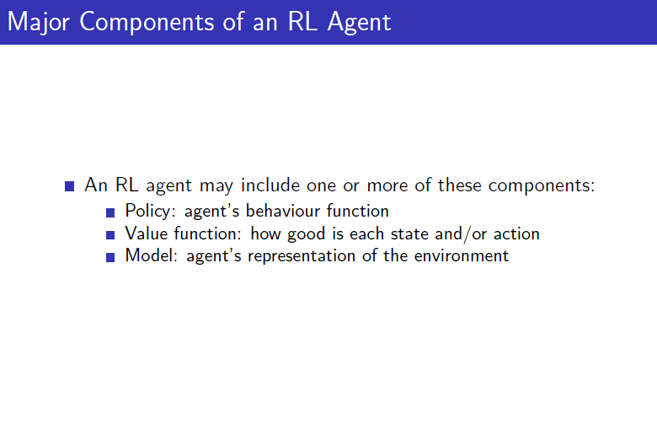

Slide 20
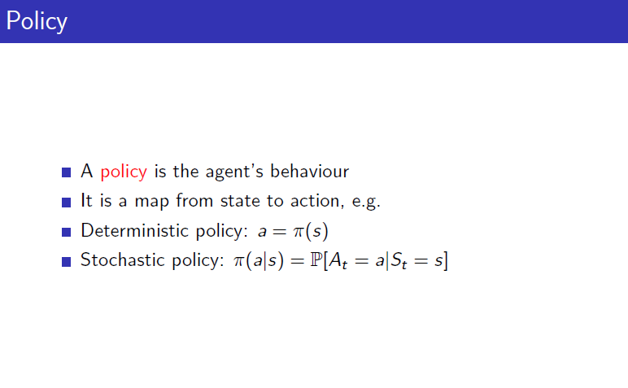

Slide 21
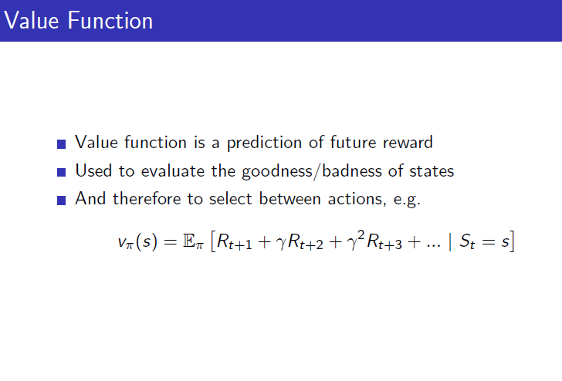

Slide 22
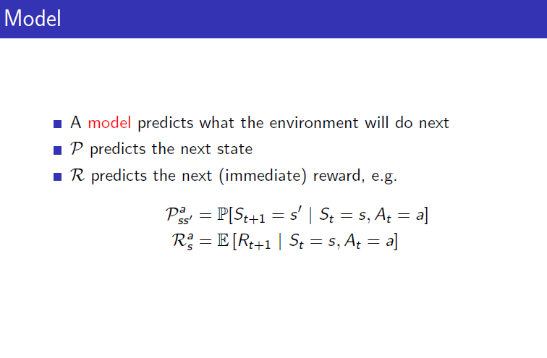

Slide 23
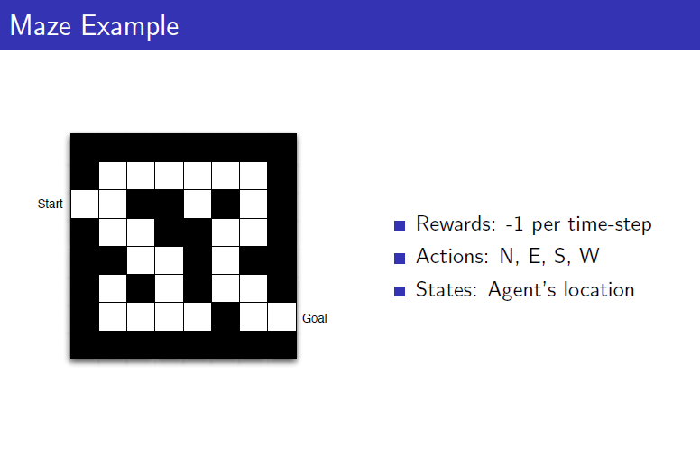

Slide 24
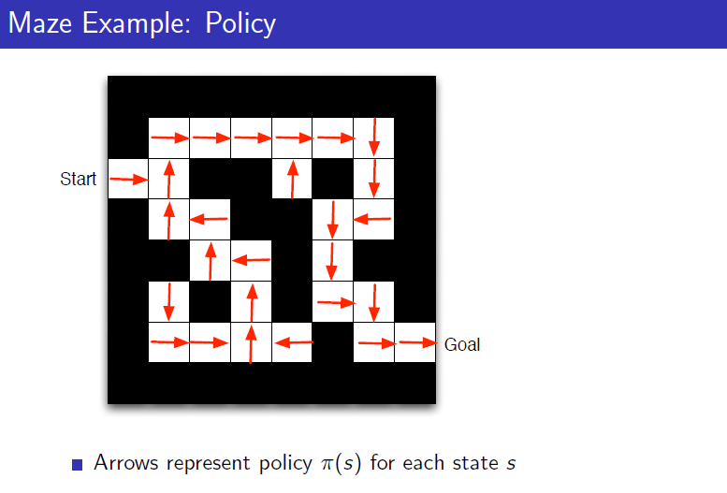

Slide 25
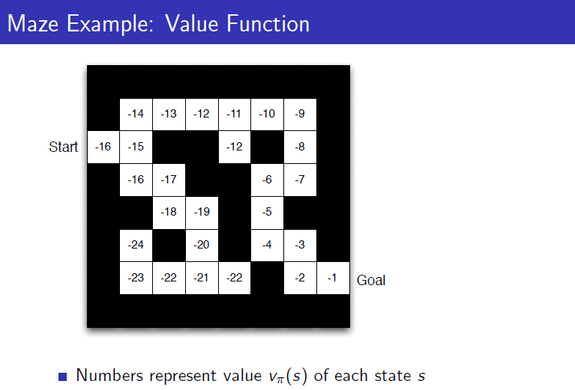

Slide 26
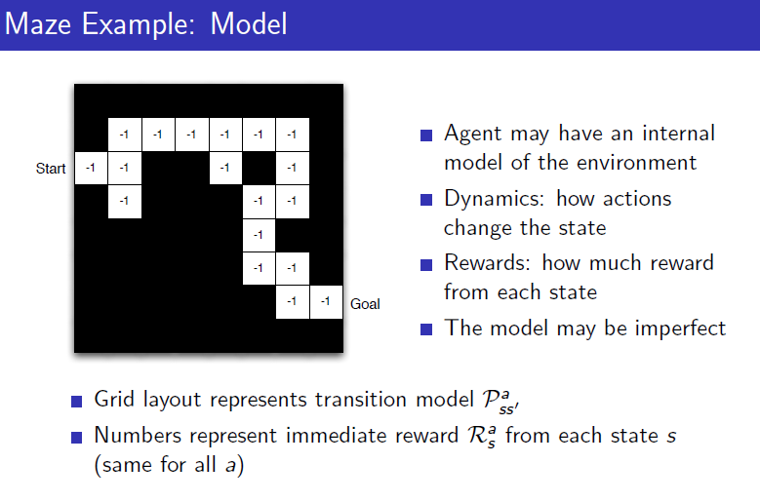

Slide 27
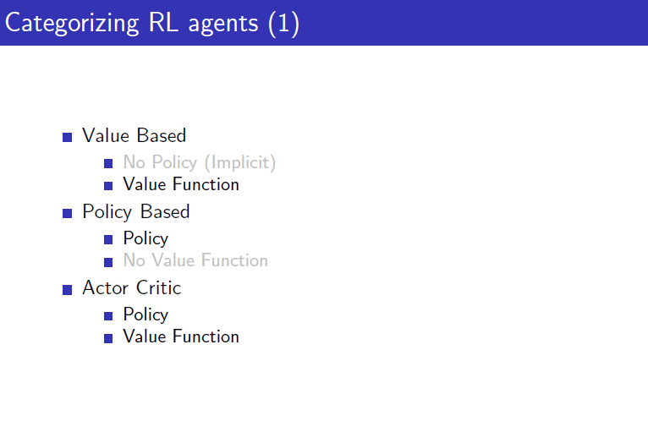

Slide 28
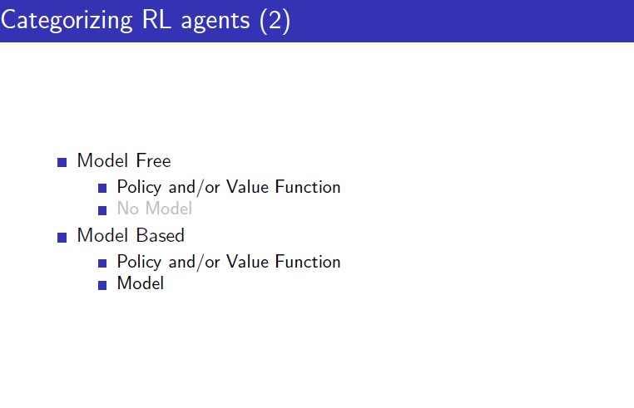

Slide 29
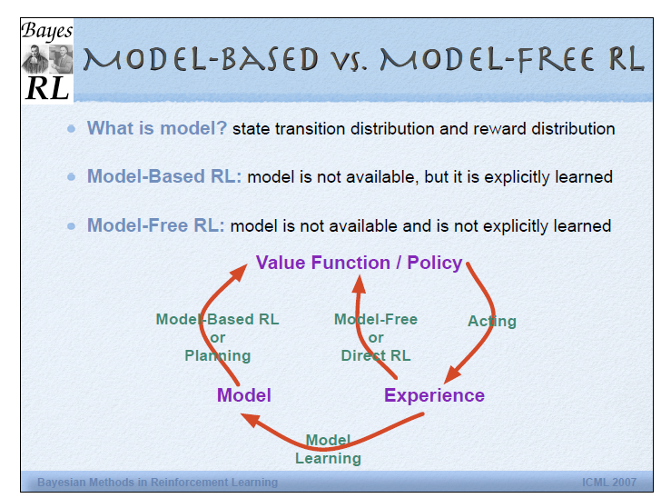

Slide 30
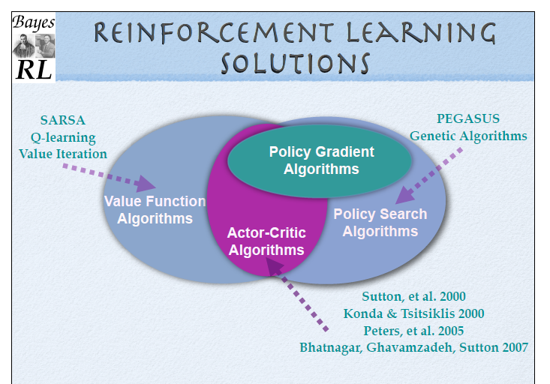

Slide 31
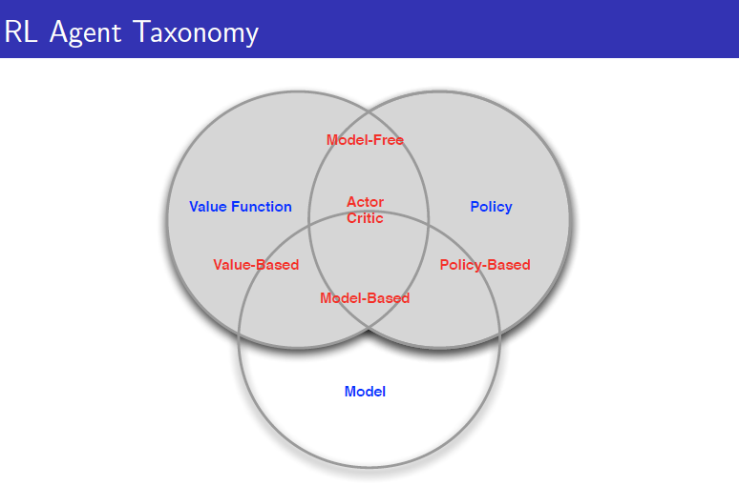

Slide 32
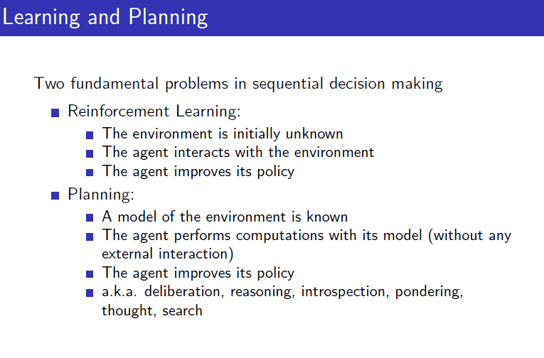

Slide 33
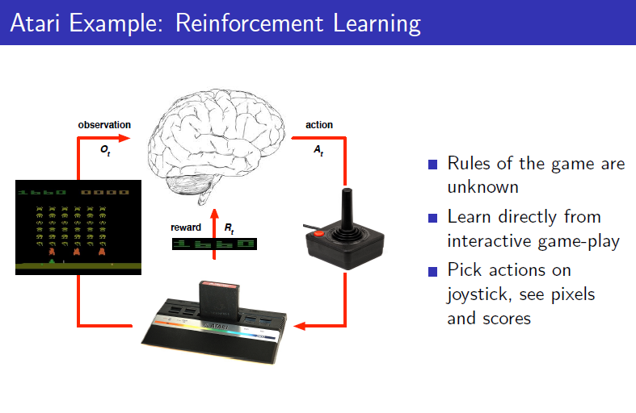

Slide 34
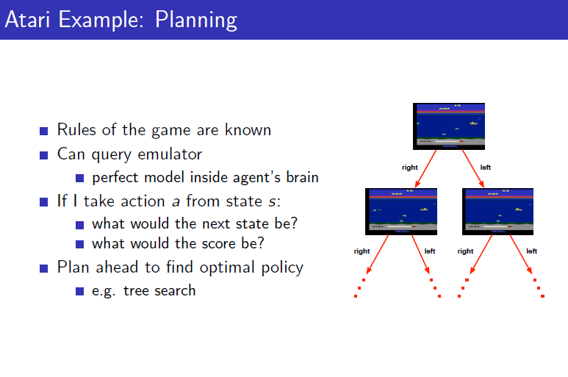

Slide 35
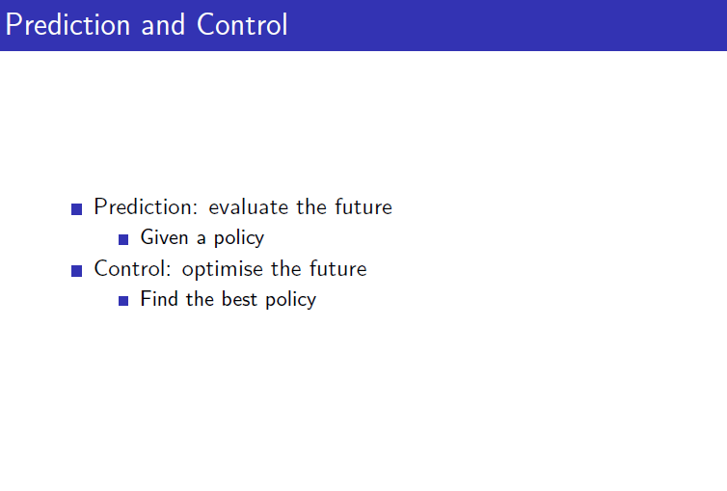

Slide 36
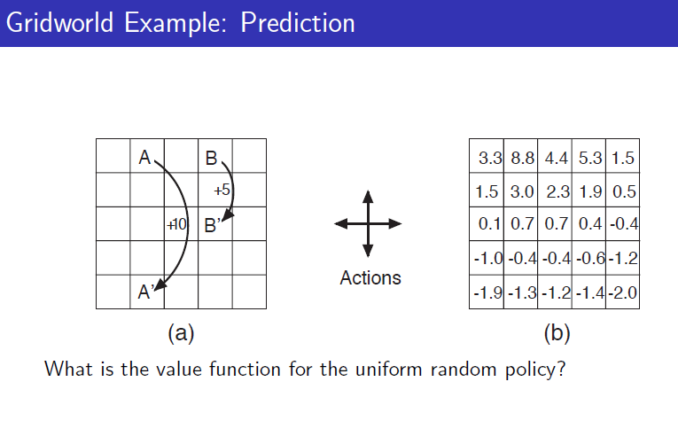

Slide 37
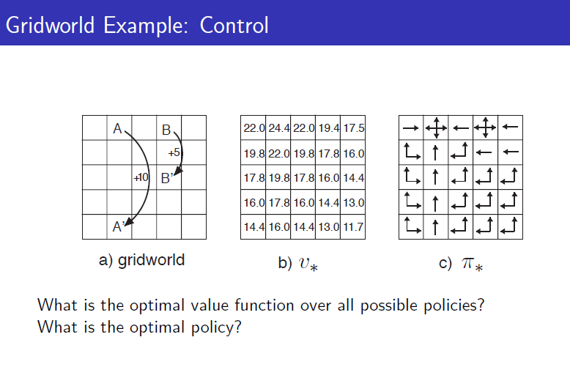

Slide 38
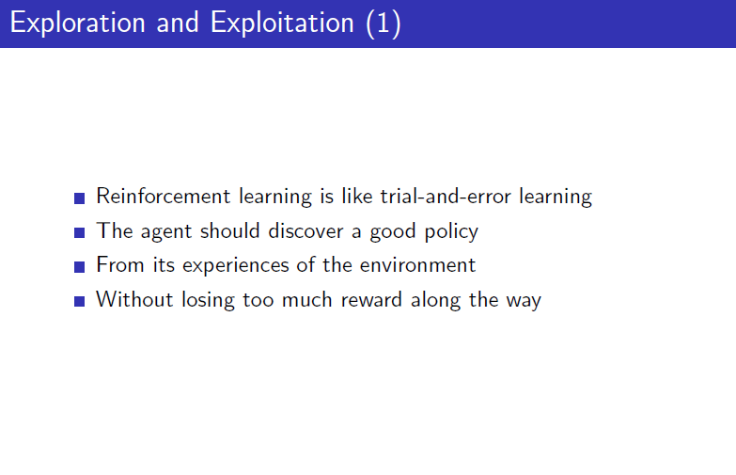

Slide 39
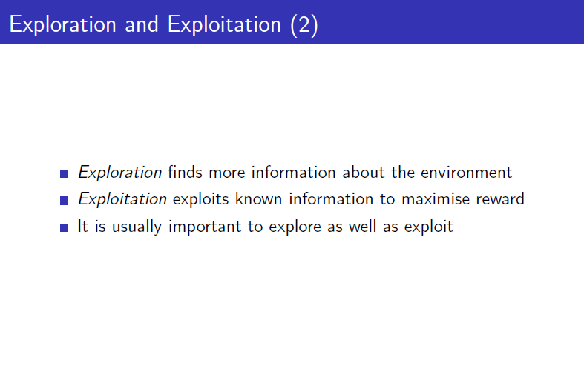

Slide 40
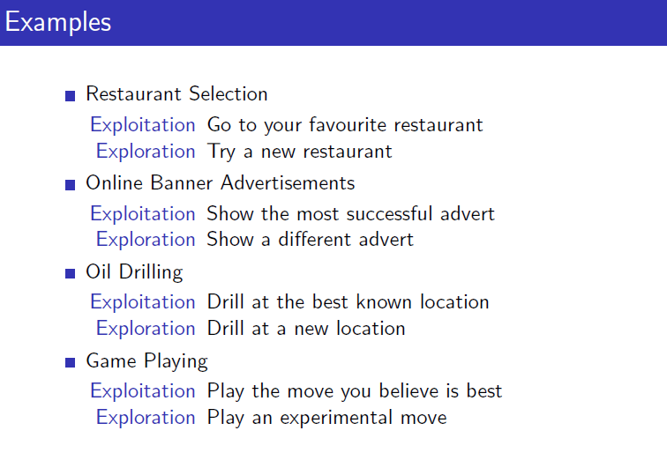

Slide 41
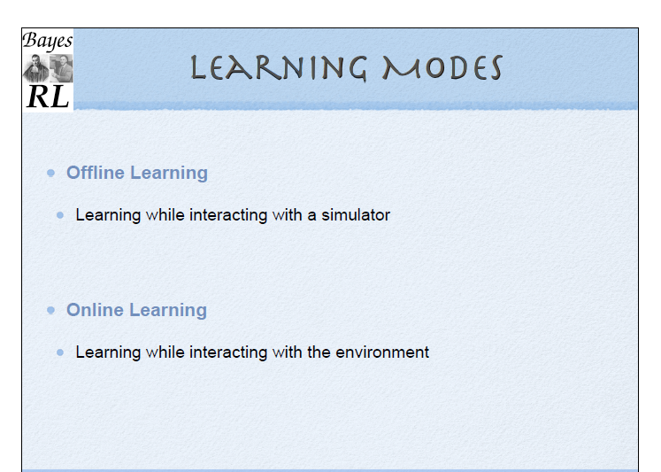

Slide 42
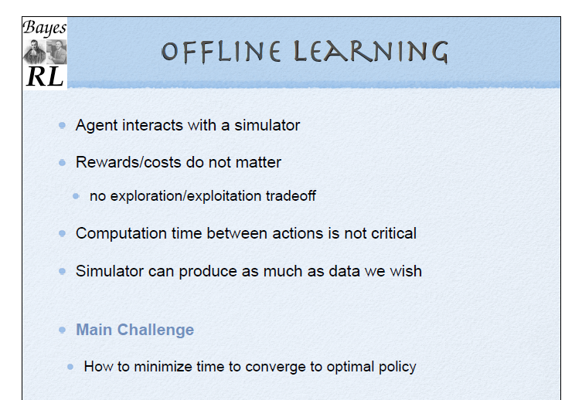

Slide 43
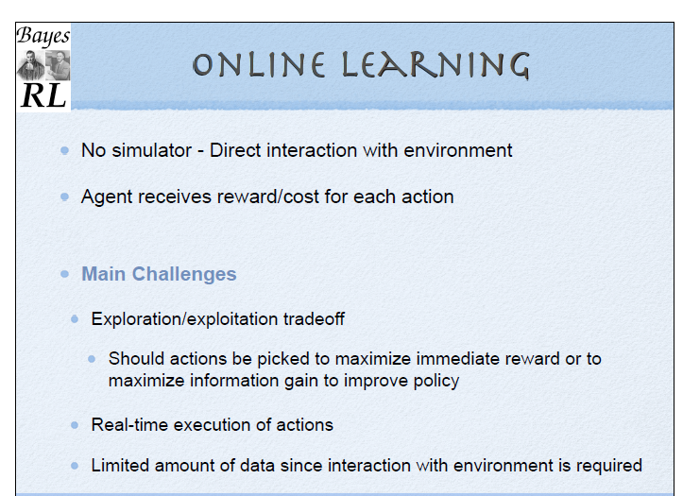

Slide 44
Q learning
Q [s,a]
s- state that we are in
a – action we can take
Q – value of taking the action a at state s
Q[s,a] = immediate reward + discounted reward

Slide 45
How to use Q?
∏(s) = argmax_{a}(Q[s,a])
∏*(s) Q*[s,a]

Slide 46
Q learning procedure - details

Slide 47
Q learning – update rule

Slide 48
Q learning - Exploration

Slide 49
Q learning procedure
Interact with the environment and identify the current state – s
Iterate over time <s, a, s’, r>
Update the Q values
Repeat until converge

Slide 50
Deep Reinforcement learning
Combining Deep Neural nets with Reinforcement learning
E.g. Deep Q learning (have a Deep NN instead of a matrix)

Slide 51
Summary
RL is used when labeled or unlabeled data is not available
Based on finding the optimum action a, that gives the maximum reward r at a state s
Model, Value function, Policy
Q learning as a value iteration, model free algorithm
Can be combined with other learning algorithms (e.g. Deep Q learning)

